Slide 1
MOVIE ANALYSIS
PHINIDY

Slide 2
AGENDA
OVERVIEW
WHO IS MY COMPETITION
FINANCIAL ANALYSIS
WHAT DO PEOPLE LIKE
SEASONAL TRENDS
RECOMENDATION

Slide 3
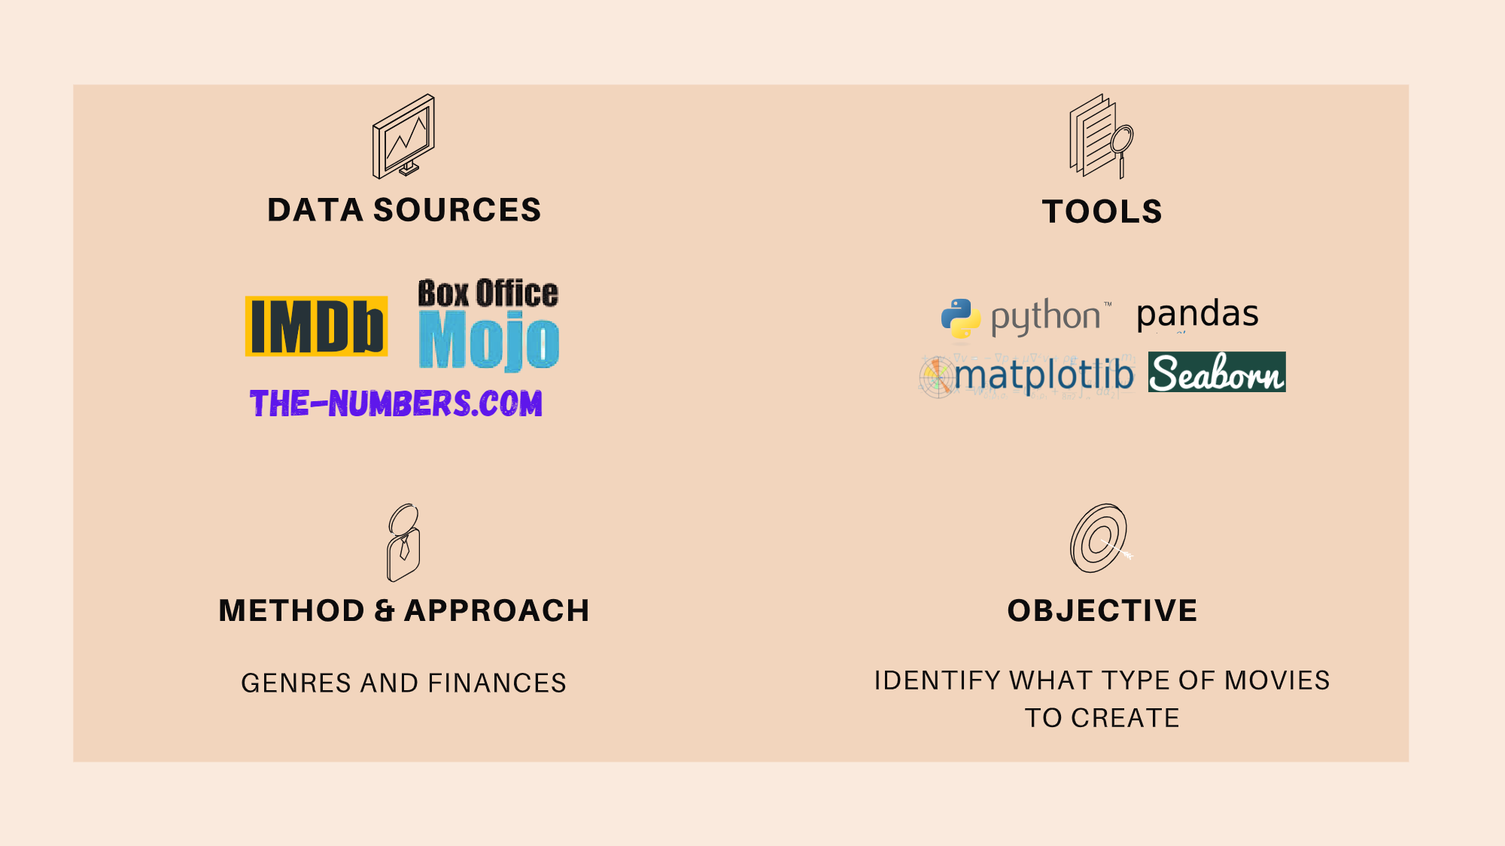

Slide 4
HYPOTHESIS
FINDING A BALANCE BETWEEN
WHAT IS MOST PROFITABLE FOR THE STUDIO AND WHAT PEOPLE LIKE WILL TELL US WHAT TYPE OF FILMS TO CREATE

Slide 5
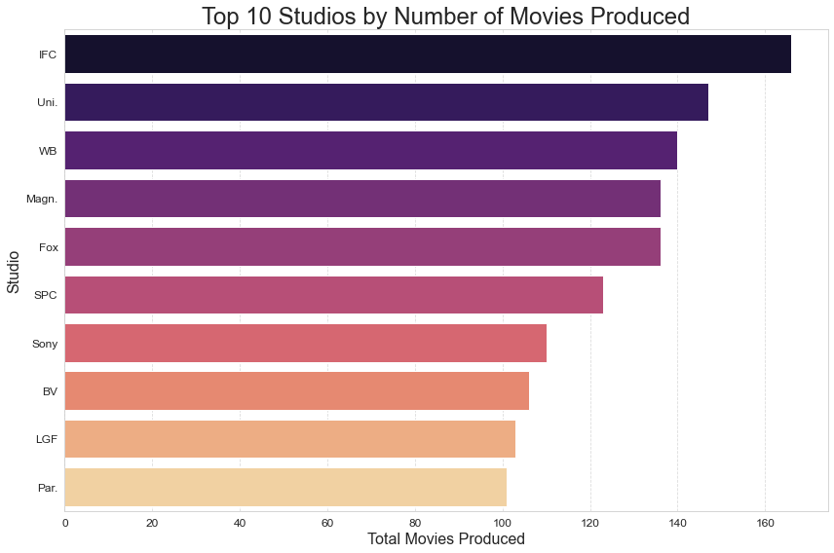
STUDIOS

Slide 6
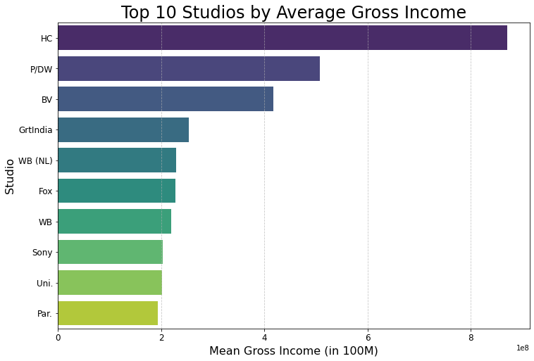
STUDIOS

Slide 7
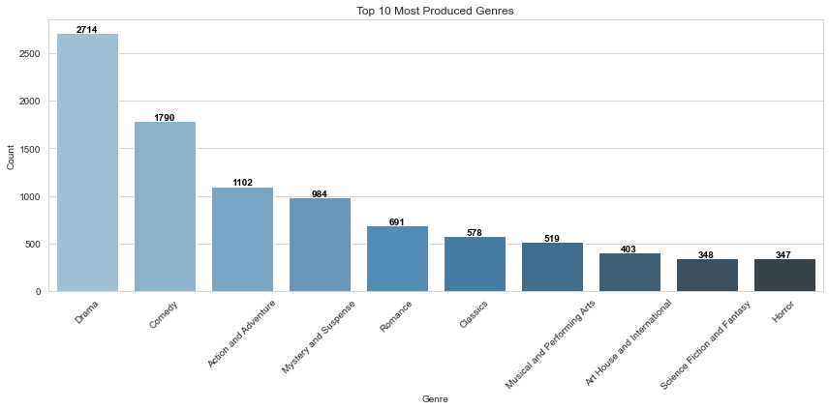

Slide 8
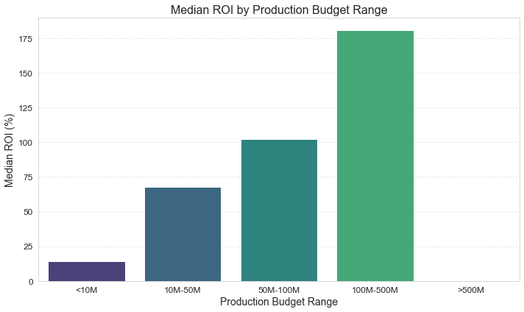

Slide 9
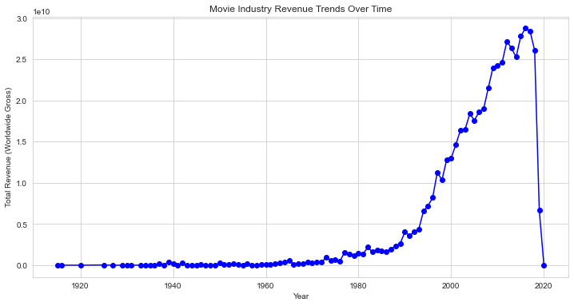

Slide 10
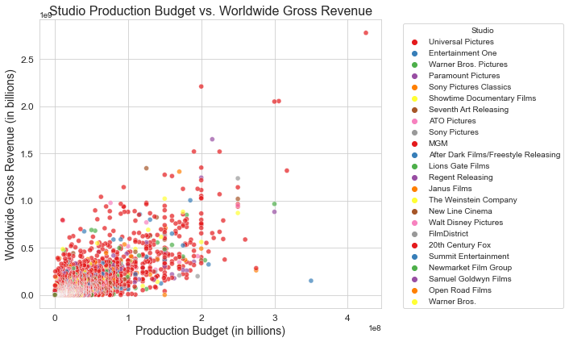

Slide 11
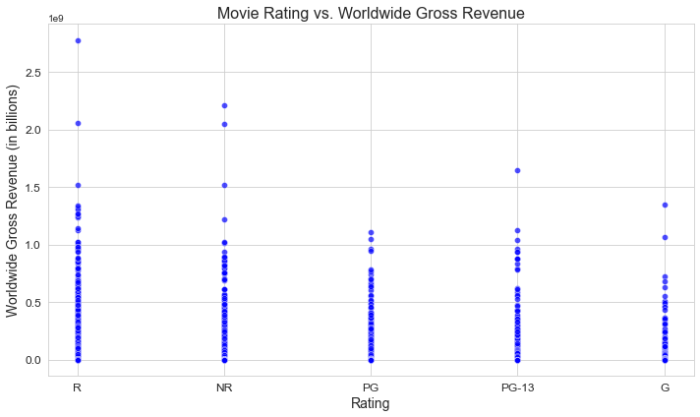

Slide 12
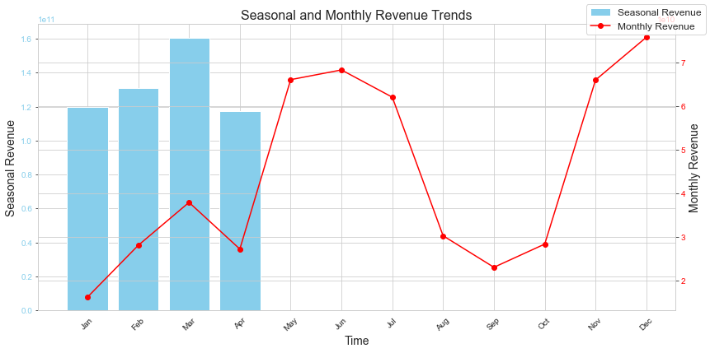

Slide 13
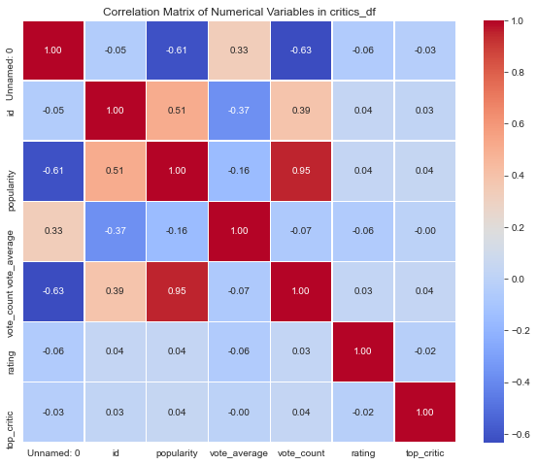

Slide 14
Thank You!
PHINIDY

